Slide 1

A New Lightweight Chaos Based Cryptosystem For IoT Devices
Presented By:
Partho Choudhury Shoumya
Roll: 1807021
Supervised By:
Dr. Kazi Md. Rokibul Alam
Professor
Department of Computer Science & Engineering
Khulna University of Engineering & Technology
Khulna -9203, Bangladesh

Slide 2
Outline
Motivation
Introduction
Related Works
Objectives
Methodology
Progress
Discussion & Conclusion
References

Slide 3
Motivation
Data communication between IoT devices are increasing rapidly
Techniques are required to keep transmitted data safe from outsiders
Some existing algorithms are no longer reliable and some of the other requires more amount of resources than IoT devices may offer
To deal with these issues, a dedicated cryptosystem is required to ensure efficient and secure IoT communication

Slide 4
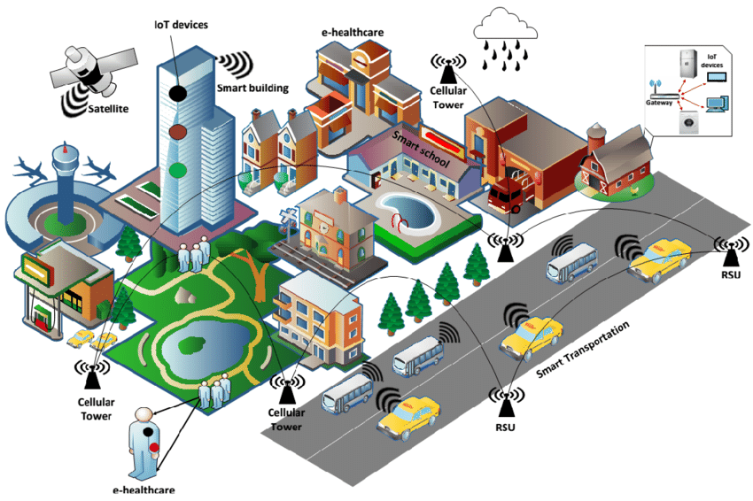
Introduction
Why IoT?
With growing amount of population, number of cities are also increasing
Cities face problems such as pollution, traffic congestion and waste management.
Experts suggest to connect these systems to internet to maintain them easily and efficiently.
This leads to the concept of Internet of Things (IoT)
Fig 1: IoT network in a city

Slide 5
Introduction (Contd.)
Some Existing Algorithms
Some well known cryptographic techniques such AES, DES, RSA etc. are being used to secure IoT communications
Limitations
Not suited for constrained devices with limited resources
Lightweight Cryptosystems
Huge emphasis is being put into developing lightweight cryptosystems adapted to these constrained devices

Slide 6
Introduction (Contd.)
Why Chaos Based Cryptosystem
Chaotic systems have good cryptographic features such as unpredictability, aperiodicity, nonlinearity and high sensitivity to control parameters.
Implementation requires fewer resources than conventional approaches
Thus making it lightweight and attractive for providing strong and efficient cryptography for resource constrained nodes.

Slide 7
Related Works
Table 1: Comparison of related works
Author | Approach | Problem
Nguyen et al. [1] | Low power circuit | Hardware solution
Nesa and Banerjee [2] | Chaos based encryption algorithm built upon a quadratic sinusoidal map | No decryption process. No implementation result
Akgul et al. [3] | Uses three different chaos generators | Only text data can be encrypted

Slide 8
Objectives
Dedicated cryptographic algorithm: To design a technique that can be used by nodes having limited memory, CPU capability, power resource etc.
Ensuring security: The lightweight technique must ensure security in communication between the nodes
Covering all types of data: The algorithm must work for all types of data such as text, image, voice etc.

Slide 9
Methodology
An overview of the proposed methodology is as follows:
Original Data,
D
Permutations Block
P = permute(M,D)
Diffusion Block
C = xor(key,P)
Encrypted Data, C
Random Generator
a1, b1, c1
X01, Y01 , Z01
Random Generator
a2, b2, c2
X02, Y02 , Z02
Original Data,
D
Inverse
Permutations Block
D = Ipermute(M,P)
Inverse
Diffusion Block
P = xor(key,C)
Encrypted Data, C
Fig 2: Overview of the proposed methodology

Slide 10
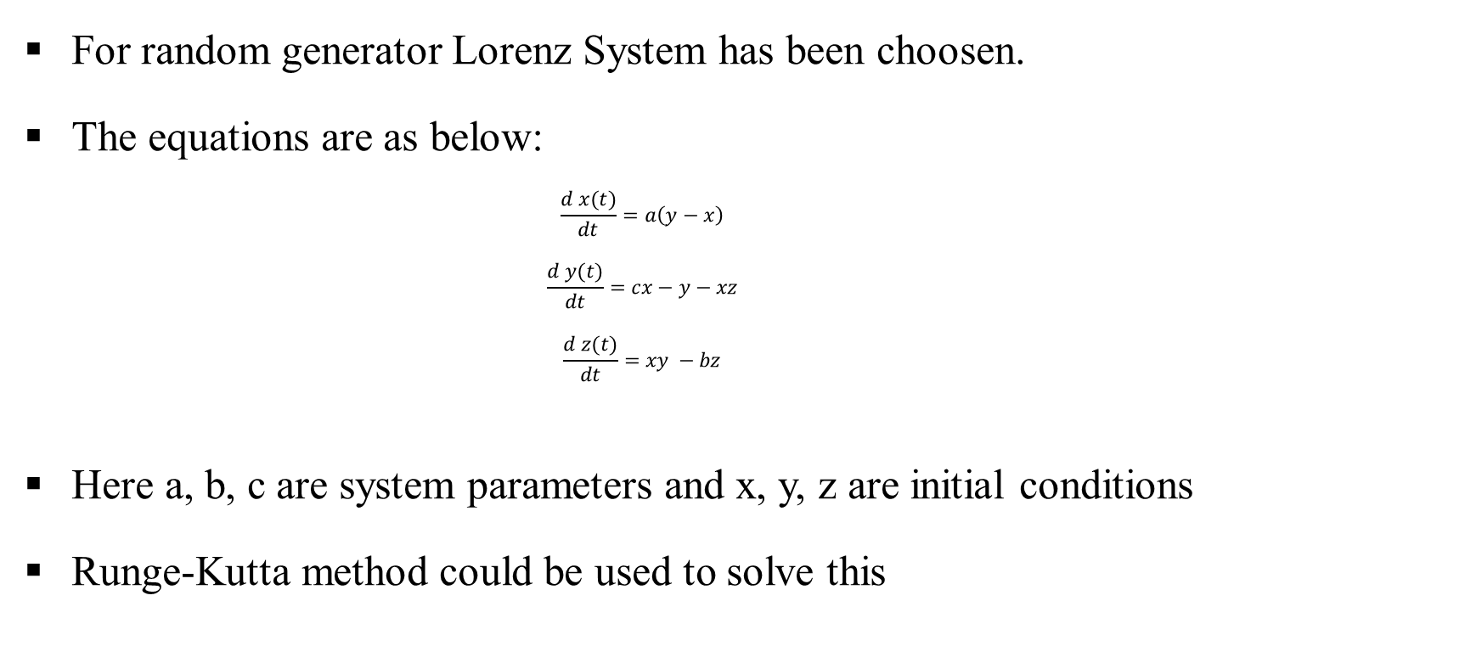
Methodology (Contd.)
For random generator Lorenz System has been choosen.
The equations are as below:
$$\frac{d x(t)}{dt}=a\left(y−x\right)$$
$$\frac{d y(t)}{dt}=cx−y−xz$$
$$\frac{d z(t)}{dt}=xy −bz$$
Here a, b, c are system parameters and x, y, z are initial conditions
Runge-Kutta method could be used to solve this

Slide 11
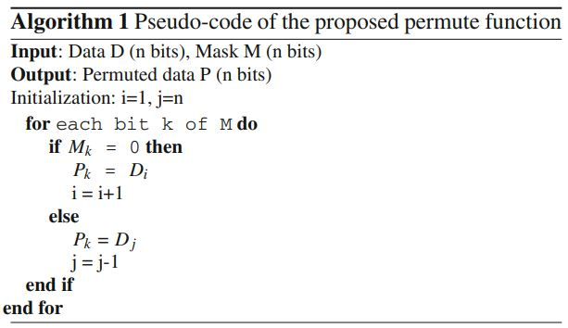
Methodology (Contd.)
Primarily the below algorithm is designed to perform encryption process:

Slide 12
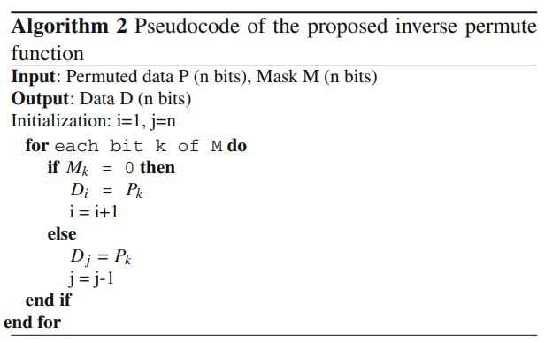
Methodology (Contd.)
Primarily the below algorithm is designed to perform decryption process:

Slide 13
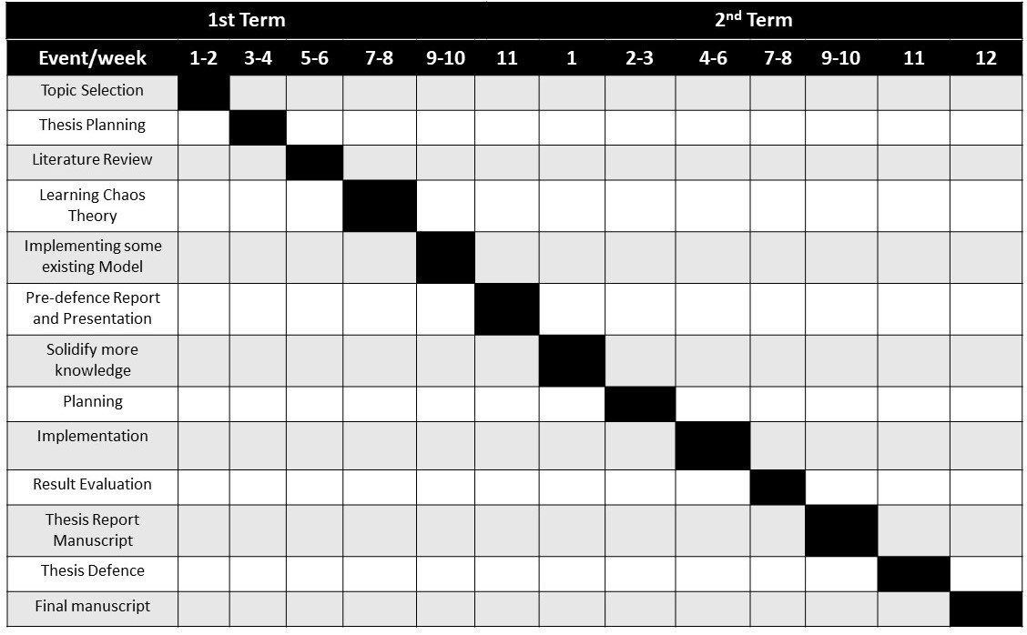
Progress
Fig 2: Gantt chart depicting thesis progress

Slide 14
Discussion & Conclusion
Key features:
Have 3 essential components: Lorenz based random generator, Chaotic permutation XOR operation
Provides enough powerful protection against brute-force attack
Suitable to use in resource constrained IoT nodes
Future Work:
Develop a key sharing mechanism
A lightweight security protocol that involves authentication of deployed IoT devices

Slide 15
References
[1] Nguyen, N., Pham-Nguyen, L., Nguyen, M.B., Kaddoum, G.: A low power circuit design for chaos-key based data encryption. IEEE Access 8, 104432–104444 (2020)
[2] Nesa, N., Banerjee, I.: A lightweight security protocol for iot using Merkle hash tree and chaotic cryptography. In: Advanced Computing and Systems for Security, pp. 3–16. Springer (2020). https://doi.org/10.1007/978-981-13-8969-6_1
[3] Akgül, A., Kaçar, S., Aricıo ˘glu, B., Pehlivan, I.: Text encryption by using one-dimensional chaos generators and nonlinear equations. In: 2013 8th International Conference on Electrical and Electronics Engineering (ELECO), pp. 320–323. IEEE (2013). https://doi.org/10.1109/ELECO.2013.6713853

Slide 16
Thank you

Slide 17
QUESTIONS?

